Slide 1

DATABASES AND APPLICATIONS
SUBJECT CODE : UQ23CA653A
Samyukta D Kumta
Computer Applications

Slide 2
DATABASES AND APPLICATIONS
UNIT-IV- Non Relational Database Types
Graph Database
Graph databases are critical databases used in industry.
A graph database organizes data as nodes, which are like records in a relational database, and relationships, which represent connections between nodes
Relationships are the key concept in graph databases, representing an abstraction that is not directly implemented in RDBMS or other NoSQL databases.
Using Graph algorithms searching of node or traversal is done.
Graph database works good with complex relationship systems.

Slide 3
DATABASES AND APPLICATIONS
UNIT-IV- Non Relational Database Types
Graph Database
Graph databases are applied in systems that share relationships between values, such as social networks, reservation systems, fraud detection, or customer relationship management systems.
Graph databases address significant limitations of existing relational database management systems (RDBMS).
Graph databases do not utilize foreign keys or join operations. Instead, all relationships are natively stored within vertices.

Slide 4
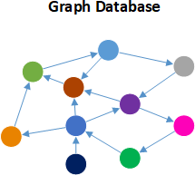
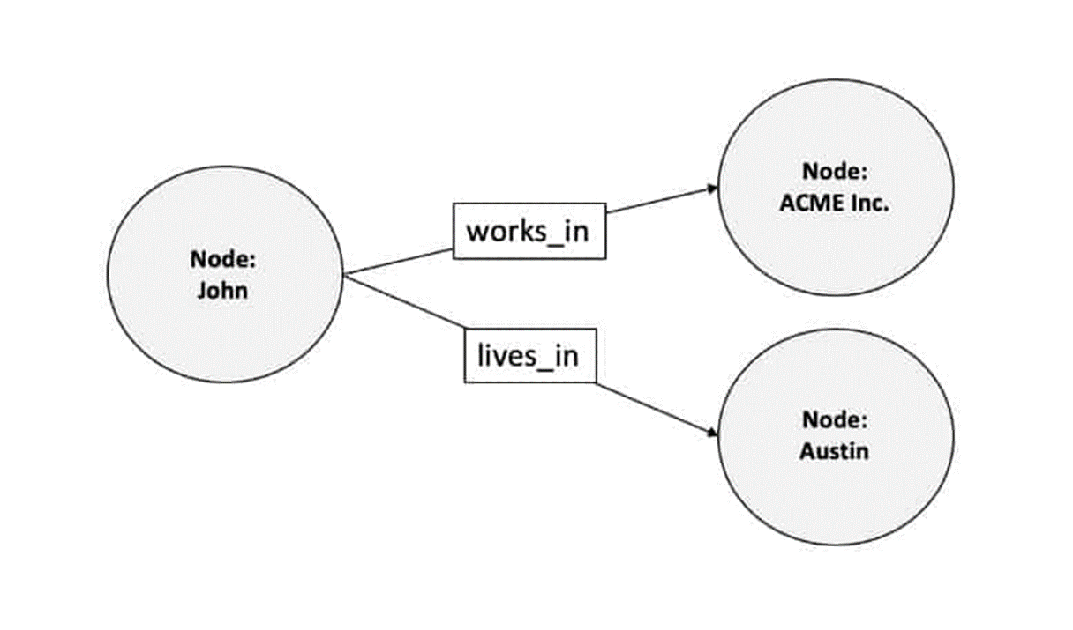
DATABASES AND APPLICATIONS
UNIT-IV- Graph Database
Graph databases contain four types of data fields (nodes, relationships, properties, & labels):

Slide 5
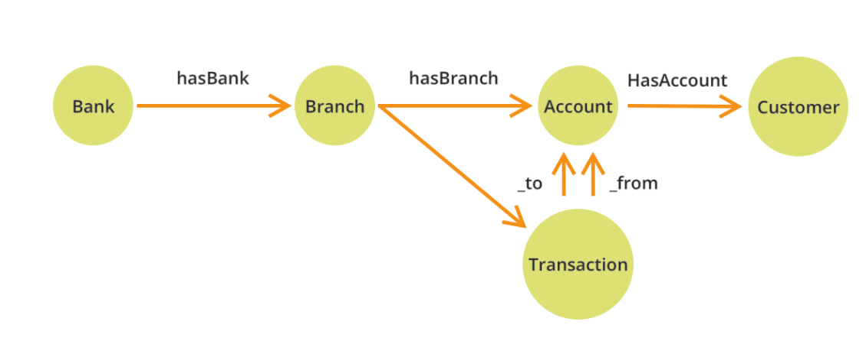
DATABASES AND APPLICATIONS
UNIT-IV- Example of Graph Database
Example : Bank Database

Slide 6
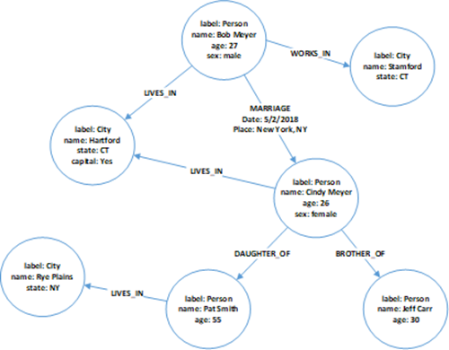
DATABASES AND APPLICATIONS
UNIT-IV- Example of Graph Database
Example : Employee Database

Slide 7
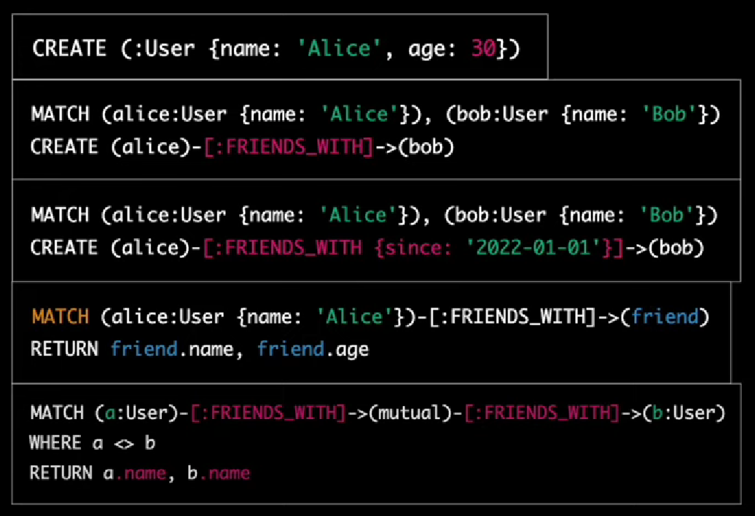
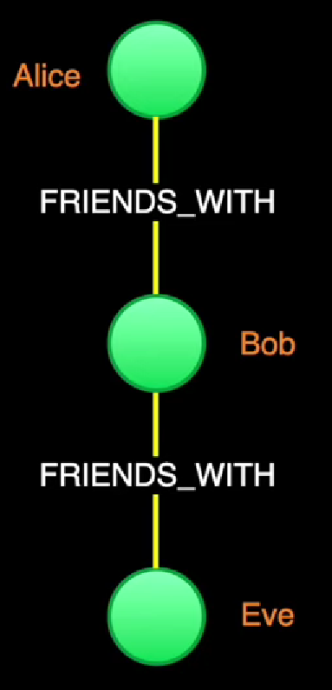
DATABASES AND APPLICATIONS
UNIT-IV- Example of Graph Database using neo4j

Slide 8
DATABASES AND APPLICATIONS
UNIT-IV- Non Relational Database Types
Applications of Graph Database
Social Network
Recommendation system
Knowledge management
Fraud Detection
Network grid designs
Supply chain nodes and mappings

Slide 9
DATABASES AND APPLICATIONS
UNIT-IV- Non Relational Database Types
Popular Graph Databases
Neo4j
Amazon Neptune
Microsoft Azure Cosmos DB
Janus Graph
Nebula Graph
Memgraph

Slide 10

THANK YOU
Samyukta D Kumta
Department of Computer Applications
samyuktad@pes.edu

